Slide 1
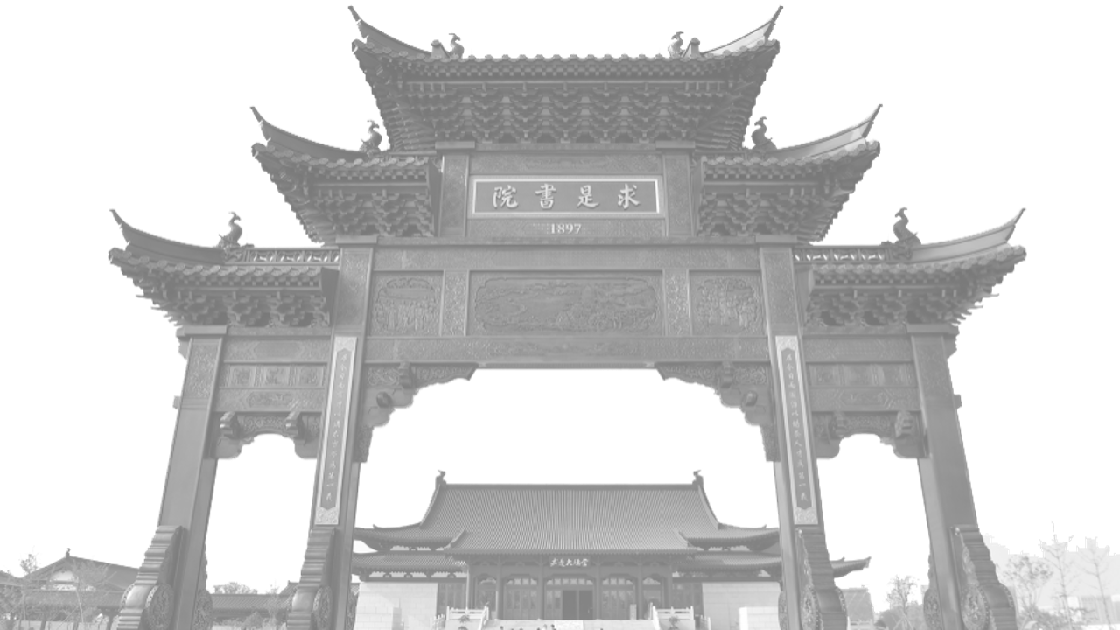
基于机器学习的动漫插帧算法
结题答辩
小组成员：王海纳（答辩人）、苏厚先、王治智
指导教师：王高昂
Notes:
使用说明：
1、这里是1#封面；

Slide 2
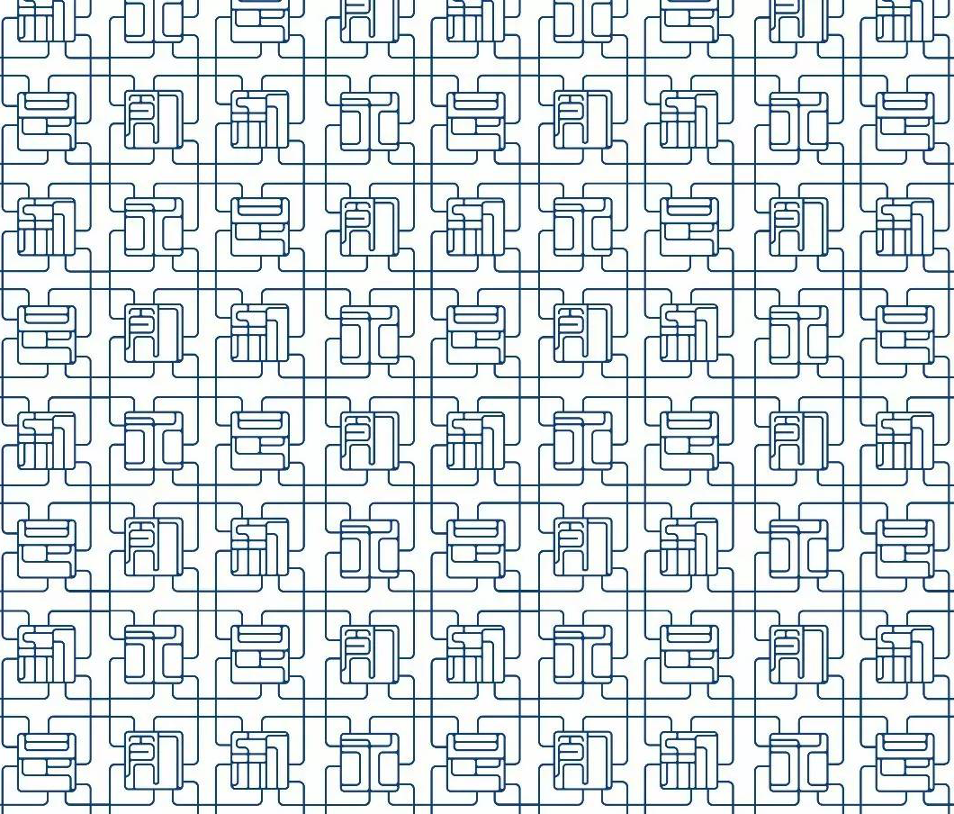

00 Demos
CONTENTS
01 Opening & Mid Reviews
02 Methods
03 Analysis
04 Discussion, Inspiration & Thoughts
Notes:
使用说明：
1、这里是1#目录页

Slide 3
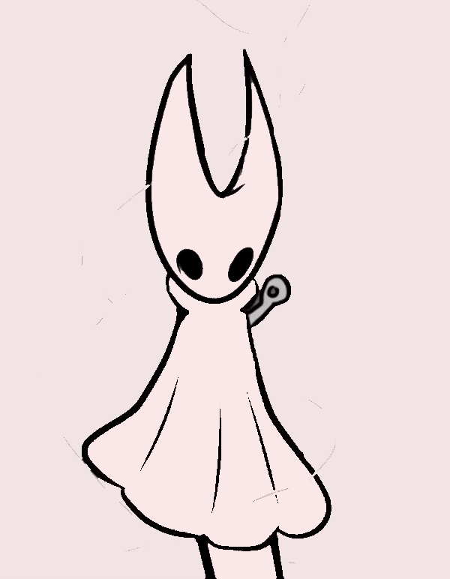
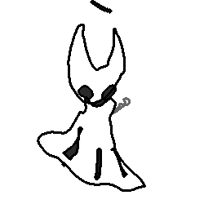
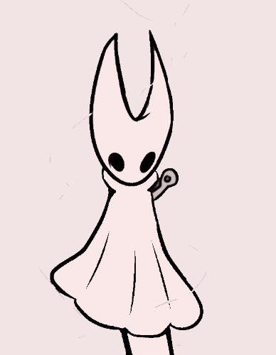
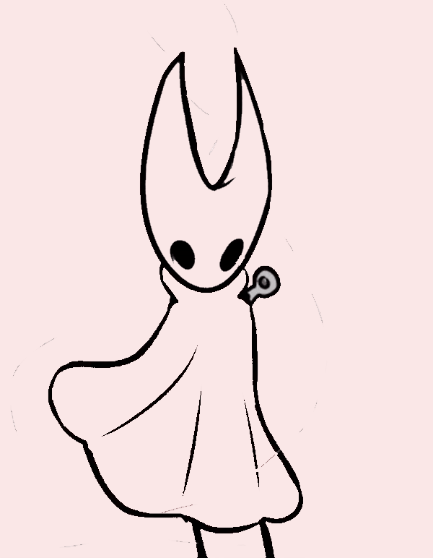
00 Demos(1/3)
Demo1 (Ch: Hornet from Hollow Knight)
Original Image
Result
Copyright: Team Cherry
Notes:
使用说明：
1、这里是二段式文字页
2、文本框可自由填入内容，如文字过多，会自动缩排

Slide 4

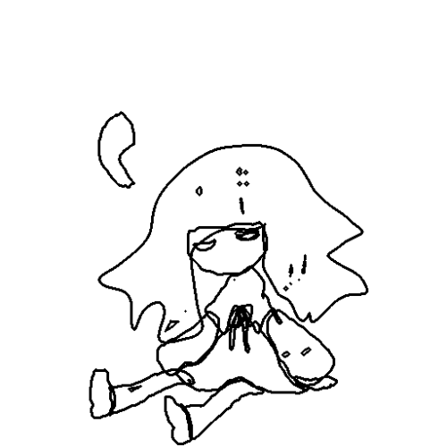


00 Demos(2/3)
Demo2 (Ch: Alice from Deemo)
Original Image
Result
Copyright: Rayark Games
Notes:
使用说明：
1、这里是二段式文字页
2、文本框可自由填入内容，如文字过多，会自动缩排

Slide 5
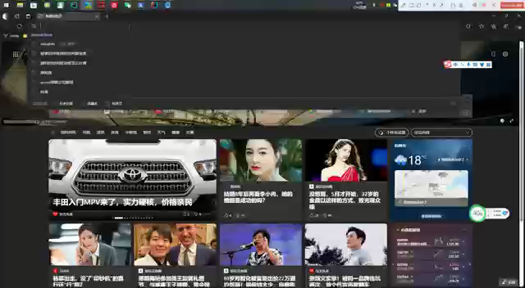
00 Demos(3/3) A front end for it

Slide 6
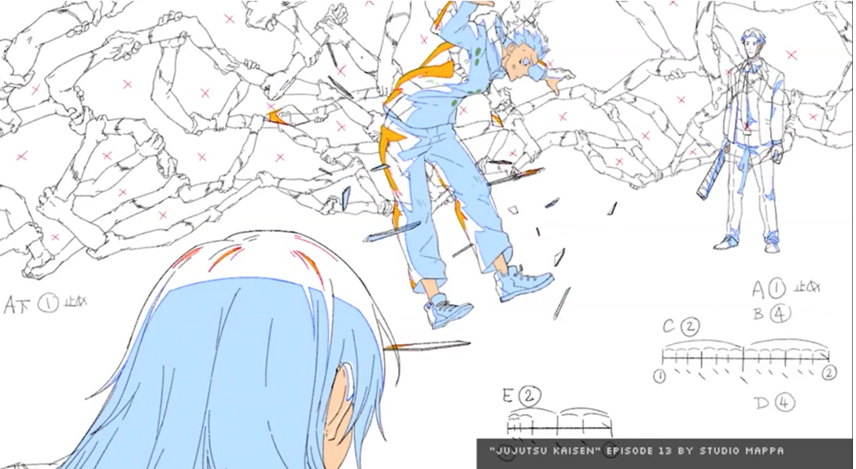
01 Opening & Mid Reviews(1/7)
Our topic is focused on the line drafts in animation production process.
Notes:
使用说明：
1、这里是另一种文字页
2、文本框可自由填入内容，如文字过多，会自动缩排

Slide 7
01 Opening & Mid Reviews(2/7)
* Casual drawings
* Unabundant or misleading colors
* Special signals:
Highlights / Shades
* Blank part:
Timeline requirement for each object.
Copyright: Jujutsu kaisen
Notes:
使用说明：
1、这里是另一种文字页
2、文本框可自由填入内容，如文字过多，会自动缩排

Slide 8
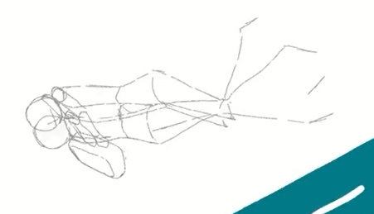
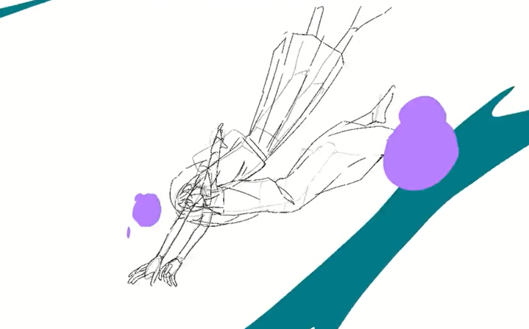

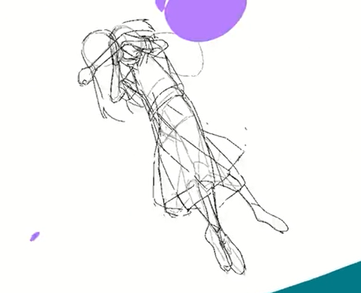
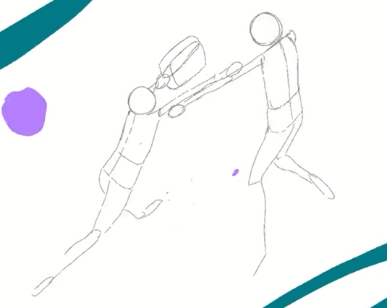
01 Opening & Mid Reviews(3/7)
Due to the need and feasibility, the inbetweenings in real may be matchstick men.
(Video from sakugabooru)
Notes:
使用说明：
1、这里是另一种文字页
2、文本框可自由填入内容，如文字过多，会自动缩排

Slide 9
01 Opening & Mid Reviews(4/7)
Technical challenges:
1) No color information
2) Non-linear, exaggerated（更大的动作） and non-trivial motions
1s=10frame;
多粒度
3) Limited state-of-the-art
Other challenges
Lack of datasets: Trade secrets
Notes:
使用说明：
1、这里是另一种文字页
2、文本框可自由填入内容，如文字过多，会自动缩排

Slide 10
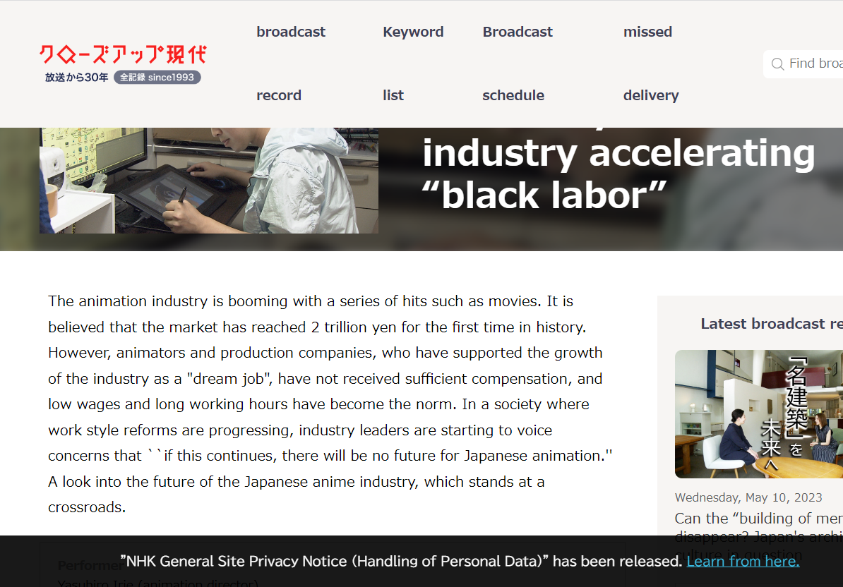
01 Opening & Mid Reviews(5/7)
At present, the inbetweening job is mostly done by trainee painters.
And this job is tiring.
Copyright: NHK. https://www.nhk.or.jp/gendai/articles/3987/
Notes:
使用说明：
1、这里是另一种文字页
2、文本框可自由填入内容，如文字过多，会自动缩排

Slide 11
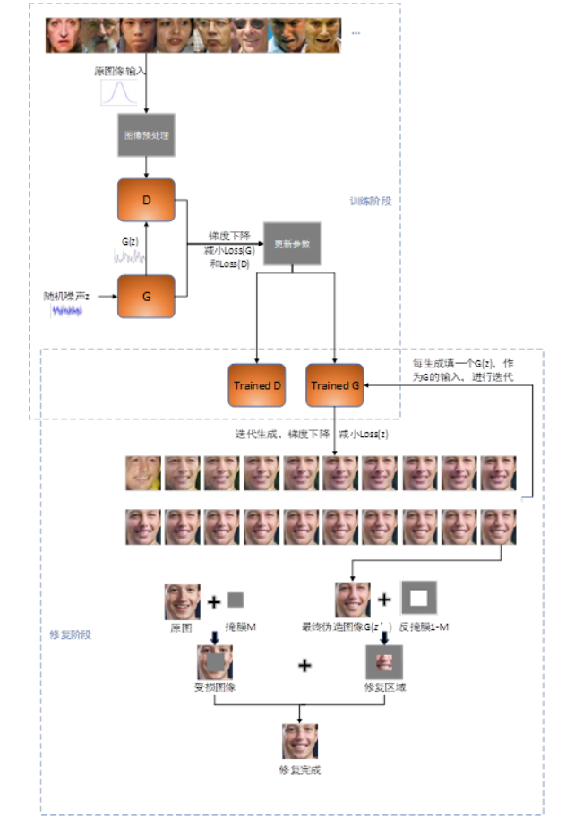





01 Opening & Mid Reviews(6/7)
Our midterm method:
Based on a image repairing model.
Calculate the difference of front/back frame, consider it as the noise and repair it.
Use atd-12k dataset.
※Only support 64*64 picture as training-set & input, so we have to cut the input into small pieces.
Notes:
使用说明：
1、这里是另一种文字页
2、文本框可自由填入内容，如文字过多，会自动缩排

Slide 12
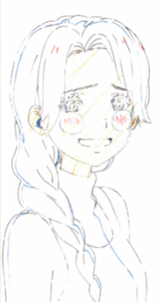
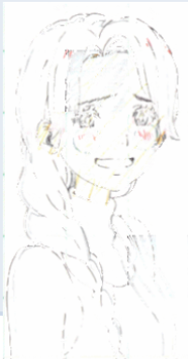
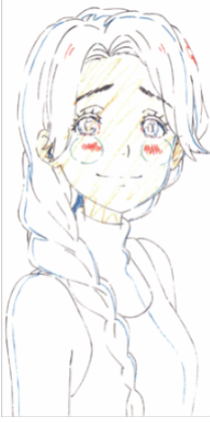
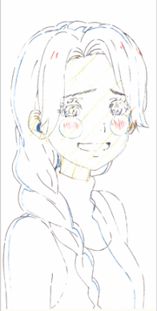
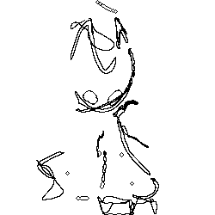
01 Opening & Mid Reviews(7/7)
This method does not address the weaknesses of existing methods at all.
Restoration models are still painting white for most of the missing parts.
So the intermediate frame looks no different from the original frame.
But after making a GIF, will you find such a rough method has a passable effect…
At least better than failed examples of our current method.
Notes:
使用说明：
1、这里是另一种文字页
2、文本框可自由填入内容，如文字过多，会自动缩排

Slide 13
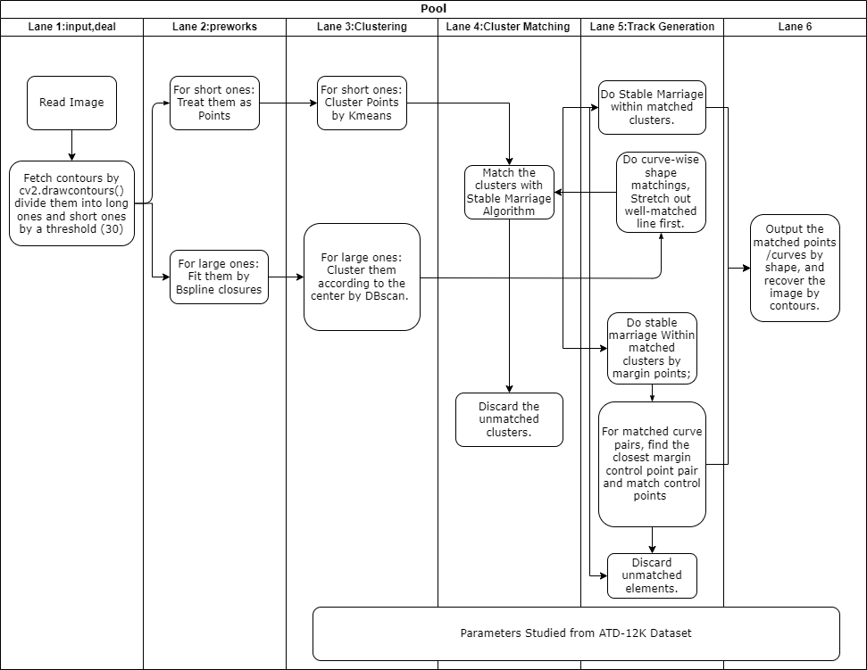
02 Methods (Overview)
Notes:
使用说明：
1、这里是另一种文字页
2、文本框可自由填入内容，如文字过多，会自动缩排

Slide 14
02 Methods (1/13)
Key Idea of our program: Use B-spline fits the long contours and match them; Trivial solution to short contours and freezing contours. Machine learning to set parameters.
Our method consist of 6 parts:
Input and finding contours
Preworks & motion findings.
Clustering
Double - Cluster matching
Track Generation
Output
Notes:
使用说明：
1、这里是另一种文字页
2、文本框可自由填入内容，如文字过多，会自动缩排

Slide 15


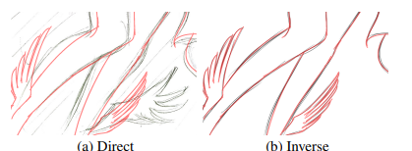
02 Methods (2/13)
A sketch simplification model and some common DIP method are used to generate sketched input.
*However their hired painter and use inverse input generation to generate data.. We don’t have the time and mind to do that, so we can’t study much from them currently.
Learning to Simplify: Fully Convolutional Networks for Rough Sketch Cleanup
Edgar Simo-Serra*, Satoshi Iizuka*, Kazuma Sasaki, Hiroshi Ishikawa (* equal contribution)
ACM Transactions on Graphics (SIGGRAPH), 2016

Slide 16
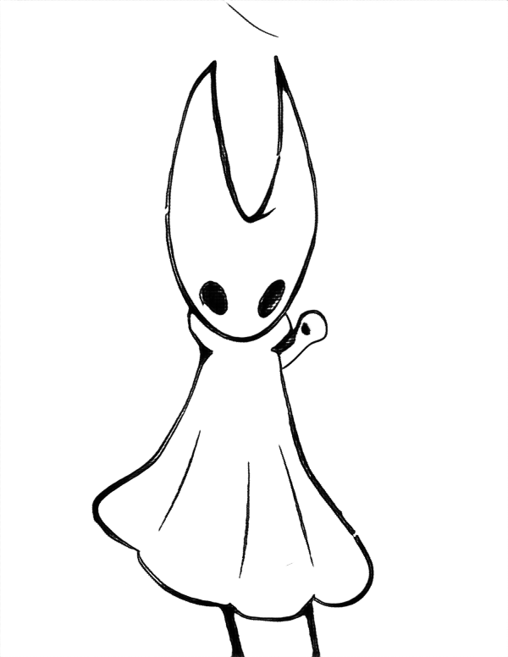
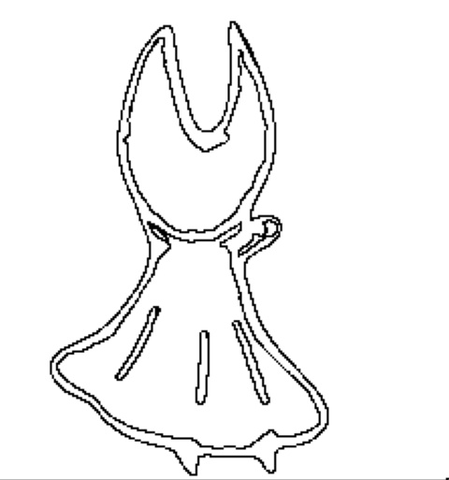
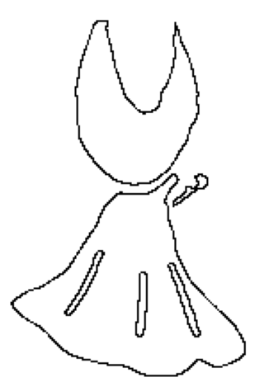
02 Methods (3/13)
Input and finding contours
Get the sketched input and use cv2.drawcontours() to find the contours.
Then based on Zhang’s thinning algorithm to simplify the long contours,
And do some dilation & erosion to keep the entity of line.
*Here we regard contours with (length > ¼ * max(h,w) or 40) to be long.
Notes:
使用说明：
1、这里是另一种文字页
2、文本框可自由填入内容，如文字过多，会自动缩排

Slide 17
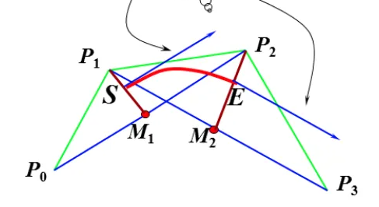
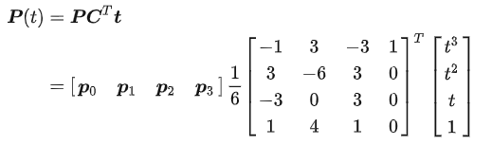
02 Methods (4/13)
Preworks
Short contours are treated as points.
Use B-Spline fitting to fit the long contours into 3rd-order continuous B-splines.
Here we use this as the base:
Number of control points per contour is currently set about 60, and can be easily changed if it’s needed.
Wang et al. - Fitting B-Spline Curves to Point Clouds by Squared Distance Minimization
Notes:
使用说明：
1、这里是另一种文字页
2、文本框可自由填入内容，如文字过多，会自动缩排

Slide 18
02 Methods (5/13)
B-spline is one the core of our idea.
We need mid-frame instead of the front/back, so no need to be too accurate.
Align all the contours into vectors with same number of control points (at least in form) , making it easier to do contour-contour matching and point-point matching.
However it has quite a few disadvantages aside from costing too much time, and will be discussed later.
Notes:
使用说明：
1、这里是另一种文字页
2、文本框可自由填入内容，如文字过多，会自动缩排

Slide 19
02 Methods (6/13)
Preworks (cont.)
After generate the data, we try to find out which contours are moving.
This is done by a trivial method:
A sub-spline is considered moving if it has too much total or consequent point leaving the target but the frame. A contour is considered moving if it has too much total or consequent sub-spline moving.
Details are parameters.
Notes:
使用说明：
1、这里是另一种文字页
2、文本框可自由填入内容，如文字过多，会自动缩排

Slide 20
02 Methods (7/13)
3) Clustering.
For short contours: treat as points, cluster by K-means.
For large contours: cluster according to the center by DB-scan.
We assume that contours belong to the same cluster should have similar movements and can be matched with regard to this.
* For simple images, mostly there will be 1 contour per cluster for the large contours.
Notes:
使用说明：
1、这里是另一种文字页
2、文本框可自由填入内容，如文字过多，会自动缩排

Slide 21
02 Methods (8/13)
4) Matching
For short-contour clusters, match them by the center with Gale-Shapley’s stable marriage algorithm.
For long-contours however, we first use structural method to stretch out long contour pairs with similar shape.
More specifically, we calculate the following values:
Cross product vector. Consist of the cross product of each pair of adjacent edges.
Length vector. Consist of the length of each edge.
The long contours with no other contours very similar to them will be matched in clusters.
Notes:
使用说明：
1、这里是另一种文字页
2、文本框可自由填入内容，如文字过多，会自动缩排

Slide 22
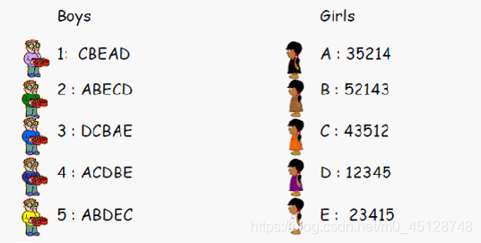
02 Methods (9/13)
4) Matching (Cont.)
After matching the clusters, we use Gale-shapley’s stable marriage algorithm to match points/contours in the matched cluster. The location of the contours is considered as its center of gravity.
To match the points on spline-pairs, we shift one spline till find their difference is minimum.
Notes:
使用说明：
1、这里是另一种文字页
2、文本框可自由填入内容，如文字过多，会自动缩排

Slide 23
02 Methods (10/13)
4) Matching (Cont.)
In case when points within 2 clusters / long contours within 2 images have nothing to match, discard them.
And we have to evaluate the matchings, if there are some pair of matchings with motions too different from their cluster, discard them.
Notes:
使用说明：
1、这里是另一种文字页
2、文本框可自由填入内容，如文字过多，会自动缩排

Slide 24
02 Methods (11/13)
5) Track generation
We’ll generate the movement track for every pair of contours and points and consider them as parametric curves.
If p1=(x1,y1) in the first frame matches p2=(x2,y2) in the second frame, it means that the curve [x(t),y(t)] has [x(0),y(0)]=p1 and [x(1),y(1)]=p2.
Currently we let them do uniform motion.
There are many ways to get complicate motions: e.g. Let x(t), y(t) be 2-order polynomials and we may perform variable speed movement.
The type of motion may not be determined by 3-tuple dataset, so we let it free.
Notes:
使用说明：
1、这里是另一种文字页
2、文本框可自由填入内容，如文字过多，会自动缩排

Slide 25
02 Methods (12/13)
6) Output
Draw freezing parts, B-splines and Points on the blank image.
Color some small connected-blocks.
For unmatched areas, fade out can be done to optimize the appearance.
Any number of inbetweening frame is ok, just to change ‘t’. In demo, we set it 16.
Notes:
使用说明：
1、这里是另一种文字页
2、文本框可自由填入内容，如文字过多，会自动缩排

Slide 26
02 Methods (13/13)
* Usage of the dataset
There are many parameters in our algorithm:
Weights for motion detect;
Weights for valuable function of structural analysis;
Weights for valuable function of clustering/matching;
…
The parameter is mainly determined by regression/iterations, and loss function is SSIM.
Notes:
使用说明：
1、这里是另一种文字页
2、文本框可自由填入内容，如文字过多，会自动缩排

Slide 27
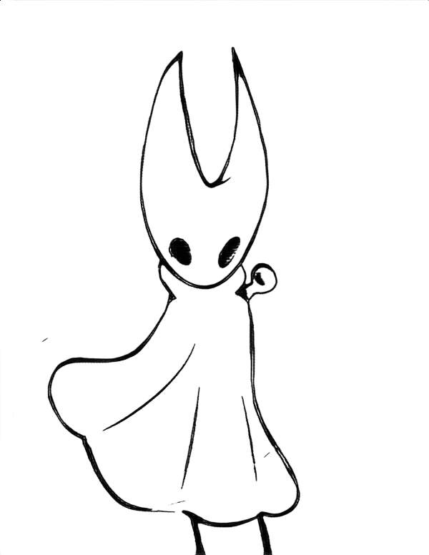
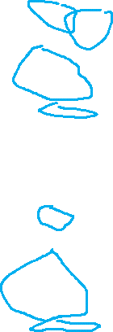
03 Results & Analysis (1/4)
Blue: Freezed long contours.
Green: belong to same cluster and later matched by Gale-shapley’s algorithm.
Yellow: single match.
Orange: missed while prework.
Other long contours are matched one-by-one.
Notes:
使用说明：
1、这里是另一种文字页
2、文本框可自由填入内容，如文字过多，会自动缩排

Slide 28
03 Results & Analysis (2/4)
This demo may elaborate the significance of different parts.
Our motion-detection and short contours step treatment are rough, but they are not the key. Instead, the matchings on the main contour lay the groundworks of the output, and it’s fatal if contour matching fails.
The influence of the cluster part is explicit, but most of the large contours can be matched with their shape. Our structural method proved to be simple but useful.
Notes:
使用说明：
1、这里是另一种文字页
2、文本框可自由填入内容，如文字过多，会自动缩排

Slide 29
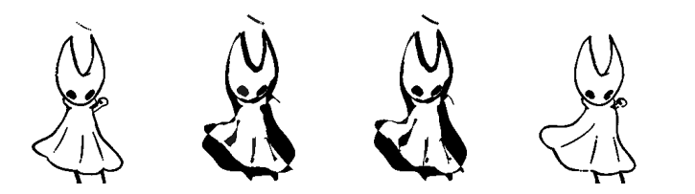
03 Results & Analysis (3/4)
The main limitation of our work comes from the peculiarity of Bspline and the limitation of cv2.findcontours & thinning.
Bspline may fit the contour mostly but not totally. This lead to detail losing and some weird movements.
Besides, the variance of contours make fixed control numbers cumbersome.
Cv2.findcontours() has poor robust: a noise can be fatal.
Re-coloring them is difficult than we have thought.
Notes:
使用说明：
1、这里是另一种文字页
2、文本框可自由填入内容，如文字过多，会自动缩排

Slide 30
03 Results & Analysis (4/4)
Further improvement on the way may involves:
Better way to divide the contours (exert restrictions from short to long..)
Better method to ensure the matchings
Faster fittings in python
Some steps replaced by machine learnings
Notes:
使用说明：
1、这里是另一种文字页
2、文本框可自由填入内容，如文字过多，会自动缩排

Slide 31

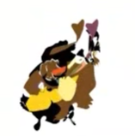
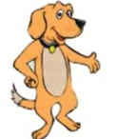
04 Discussions, Inspirations & Thoughts (1/3)
To use point-cloud or contour-set is a problem haunting us thorough the research.
At present almost everyone in the field choose the former, and have a lot of machine-learning methods. Considering the feature of our task, we choose the latter, and strive on our own way.
Thanks to a rough-sketch model we get some effort. But there may be a lot to learn from the former method.
Notes:
使用说明：
1、这里是另一种文字页
2、文本框可自由填入内容，如文字过多，会自动缩排

Slide 32
04 Discussions, Inspirations & Thoughts (2/3)
Conclusion:
In real case, given the inbetweening method do vary, B-spline make sense and our method can be use as a matchstick men drawer, and can be used to assist people to get the trend of movements between the two frame.
Some additional constraints (fixed window of movement) may help.
However various reasons make the inbetweening an extremely open and complicate task, So applications are a long way to go.
Notes:
使用说明：
1、这里是另一种文字页
2、文本框可自由填入内容，如文字过多，会自动缩排

Slide 33
04 Discussions, Inspirations & Thoughts (3/3)
Thoughts
Easy – It’s the easiest to draw ghost.
Hard – Choosing an independent topic as the first research attempt for all us three.
Satisfaction - It’s not tiresome to strive for our interest. We have tried our best.
Regrets - Tight schedule; Lack of time to dig in; Unable to try “pure” ML coding at last; Many unimplemented ideas
Notes:
使用说明：
1、这里是另一种文字页
2、文本框可自由填入内容，如文字过多，会自动缩排

Slide 34

Division of work
Haina Wang: Algorithm, back-end codings
Houxian Su: Algorithm, Realcase research, testings
Zhizhi Wang: research, front-end codings

Slide 35
Acknowledgements
Sincere gratitude to our professor Gaoang Wang and his doctor Guanhong Wang. They arranged SRTP teams into groups divided by fields and held group meetings once per 2 weeks and glad to provide advices as long as we need.
Special thanks to Zaihe Zhang in our SRTP group, we’ve consulted him numerously and even go to Haining to meet him, and he’s always glad to help us.

